Slide 1
Building Strong Community Bonds
Empowering the VFW Through Relationships & Leadership
Presented By
Assistant Director of Membership
Johnny Neal

Slide 2
Agenda
Foundations of Community Relationships
Building and Nurturing Partnerships
Leadership and Personal Qualities
Sustaining Growth and Legacy

Slide 3
Foundations of Community Relationships

Slide 4



Why Community Relationships Matter
Community Connections Drive Impact
Partnerships expand the reach of VFW programs and services.
Boost Visibility and Credibility
Active relationships position the VFW as a trusted community hub.
Fuel Membership Growth
Engagement with partners creates natural pathways for new members.

Slide 5
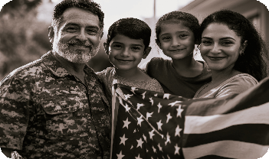
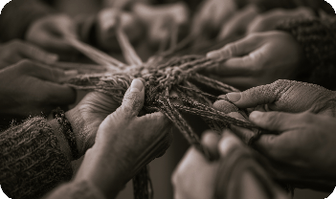
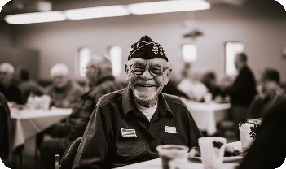
VFW Pillars: The Foundation of Relationships
Advocacy: Amplify Veteran Voices
Partner to educate the public and influence local leaders
Assistance: Expand Support Networks
Collaborate to provide vital resources and services
Camaraderie: Build Lasting Connections
Create shared experiences that unite veterans and communities

Slide 6

Aligning Relationships With Our Pillars
Embed Advocacy in Every Partnership
Expand Assistance & Services
Foster Camaraderie Through Joint Action
Align Every Initiative With VFW Values

Slide 7
Building and Nurturing Partnerships

Slide 8





Identifying Key Community Partners
Engage Diverse Community Partners
Connect with veteran, civic, public, education, health, and business groups
Leverage Internal Networks
Utilize member affiliations and Post connections for introductions.

Slide 9
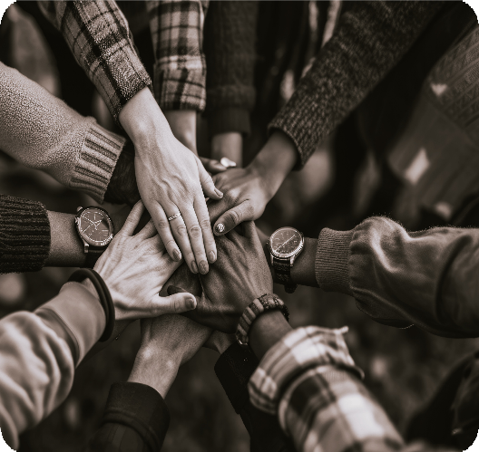
Making the First Connection Count
Learn Their Mission First
Highlight Shared Purpose
Be Clear and Concise
Invite to Serve Together

Slide 10
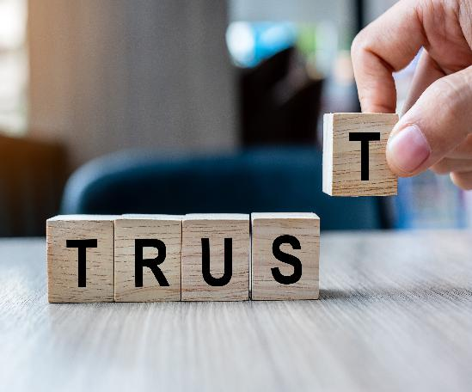
Building Trust and Mutual Respect
Consistency Builds Trust
Engage in Partner Initiatives
Share Impact and Progress
Invest for the Long Term

Slide 11

Strengthening Relationships Over Time
Consistent Communication Builds Trust
Recognize and Celebrate Partners
Deliver Ongoing Value
Share Success Stories

Slide 12
Leadership and Personal Qualities

Slide 13
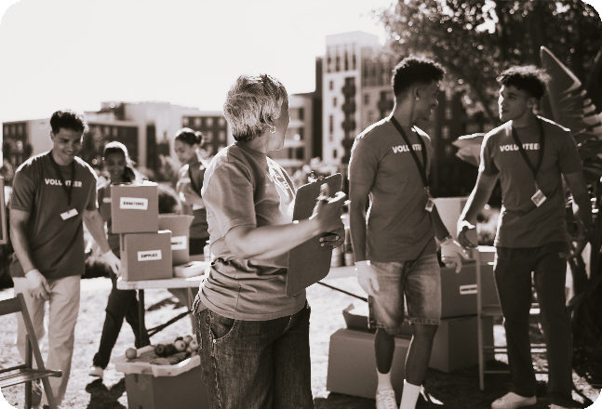
Servant Leadership in Action
Prioritize Community Needs
Foster Trust and Respect
Empower Others to Succeed
Lead by Example

Slide 14

The Power of Humility
Listen First, Speak Second
Share Credit Generously
Value Diverse Viewpoints
Build Trust Through Humility

Slide 15

Growing Membership Through Relationships
Community Connections Drive Growth
Partner Referrals Expand Our Reach
Events Spark Engagement and Belonging
Active Involvement Builds Future Leaders

Slide 16


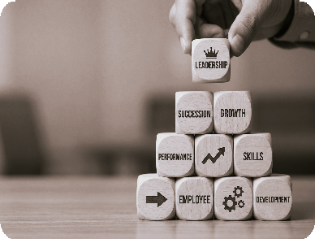
Sustaining the VFW Legacy
Preserve Knowledge for Future Leaders
Document partnerships and relationship strategies for seamless transitions.
Build Enduring Community Trust
Consistent engagement fosters credibility and VFW relevance
Model Leadership for Growth
Set standards that inspire future leaders to expand impact.

Slide 17
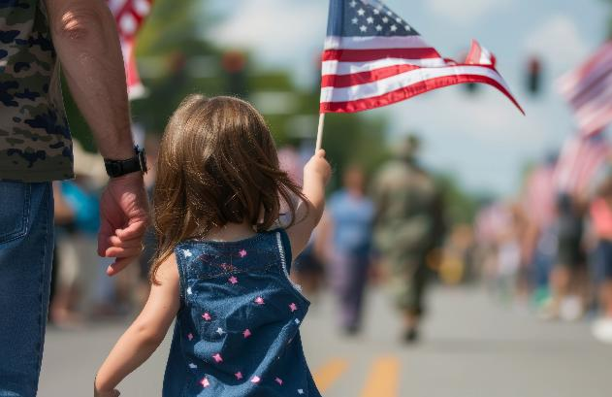
Key Takeaways for Lasting Impact
Relationships Fuel VFW Success
Align Relationships with VFW Pillars
Lead with Humility & Service
Sustain the VFW Legacy

Slide 18
Questions?

